Slide 1



my project
View in Power BI
Last data refresh:
9/2/2024 8:12:14 PM UTC
Downloaded at:
10/24/2024 6:33:19 PM UTC

Slide 2
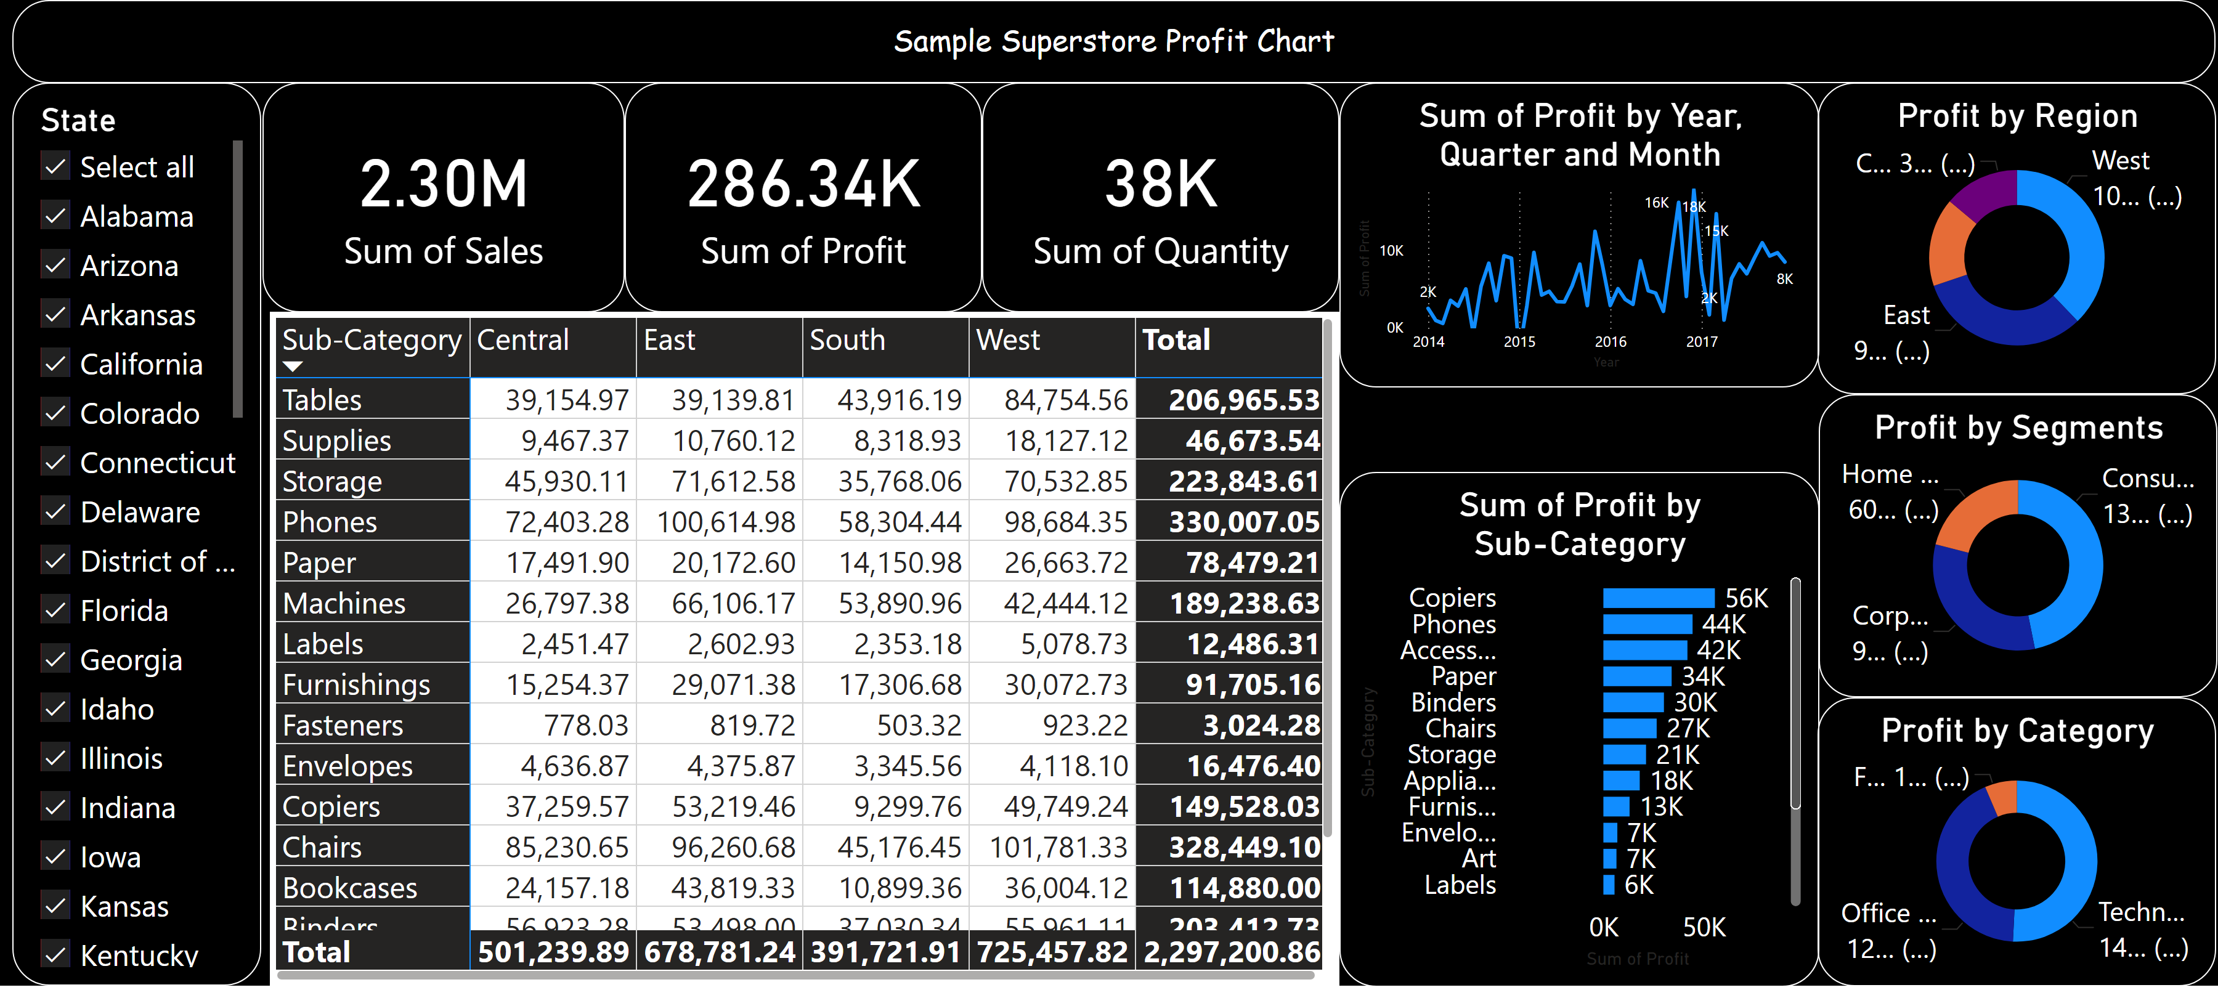
Report of the store
Notes:
textbox
No alt text provided
Profit by Category
No alt text provided
Profit by Segments
No alt text provided
Profit by Region
No alt text provided
barChart
No alt text provided
lineChart
No alt text provided
slicer
No alt text provided
pivotTable
No alt text provided
card
No alt text provided
card
No alt text provided
card
No alt text provided

